Slide 1
Integrating divergent above- and belowground carbon flux responses to rising disturbance severity
Lisa T. Haber^{*1,} Kayla C. Mathes^{*1,} Jeff Atkins²,
Ben Bond-Lamberty³, Chris M. Gough¹
Virginia Commonwealth University¹, USDA Forest Service²,
Pacific Northwest National Laboratory³

Slide 2
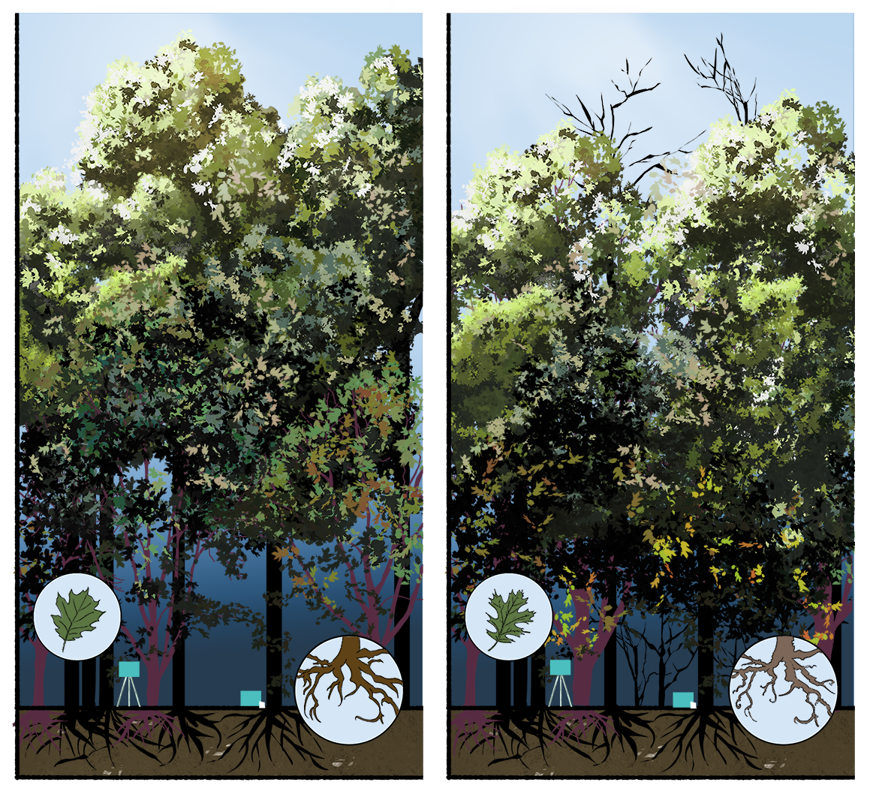
?
disturbance
Research questions:
(1) How do the above- and belowground C cycling compartments respond following disturbance at differing severities?
(2) (How) does canopy structural change control subcanopy C cycling dynamics?
(3) What are the implications for ecosystem-scale production and C balance?
Image credit: Erika Masis Laverde, VCUarts

Slide 3
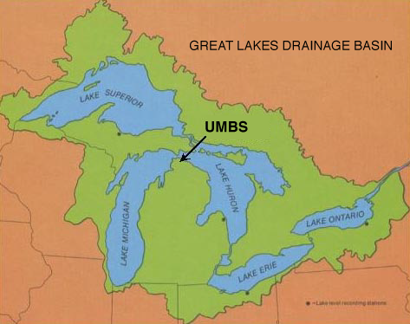
Forest Resilience Threshold Experiment (FoRTE)

Slide 4
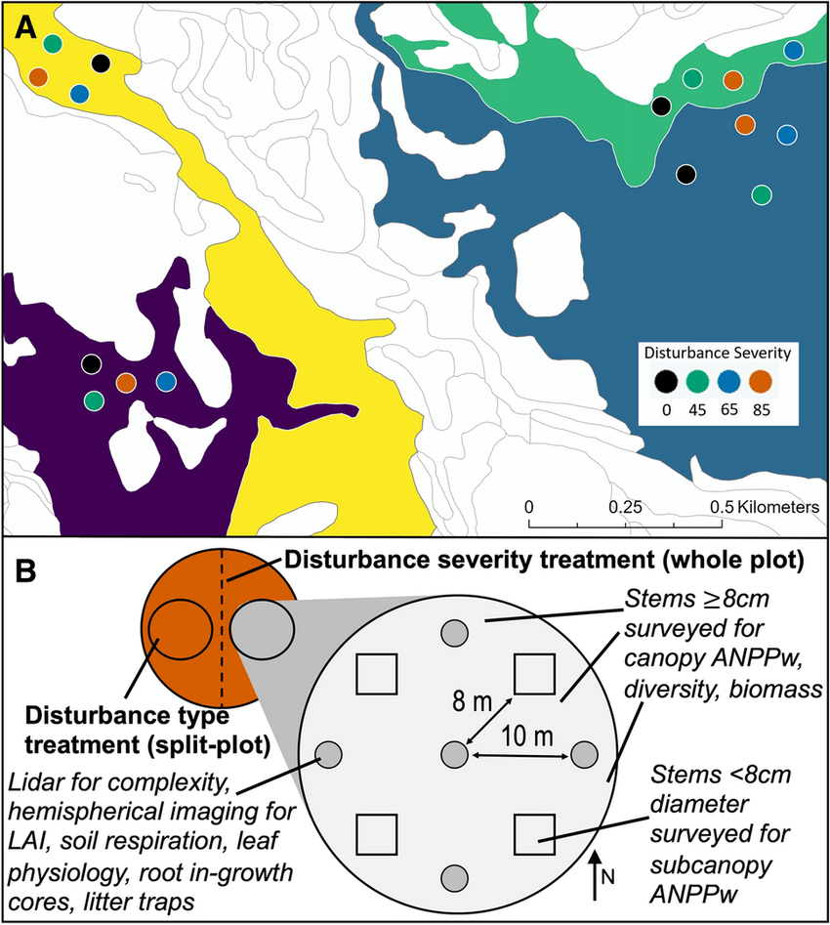
Forest Resilience Threshold Experiment (FoRTE)
~3700 stems girdled across 16 ha. in May 2019
Replicated disturbance severity gradient from 0 – 85 % gross defoliation
Four unique landforms represented
Annual measurements for a suite of above- and belowground C cycling variables

Slide 5
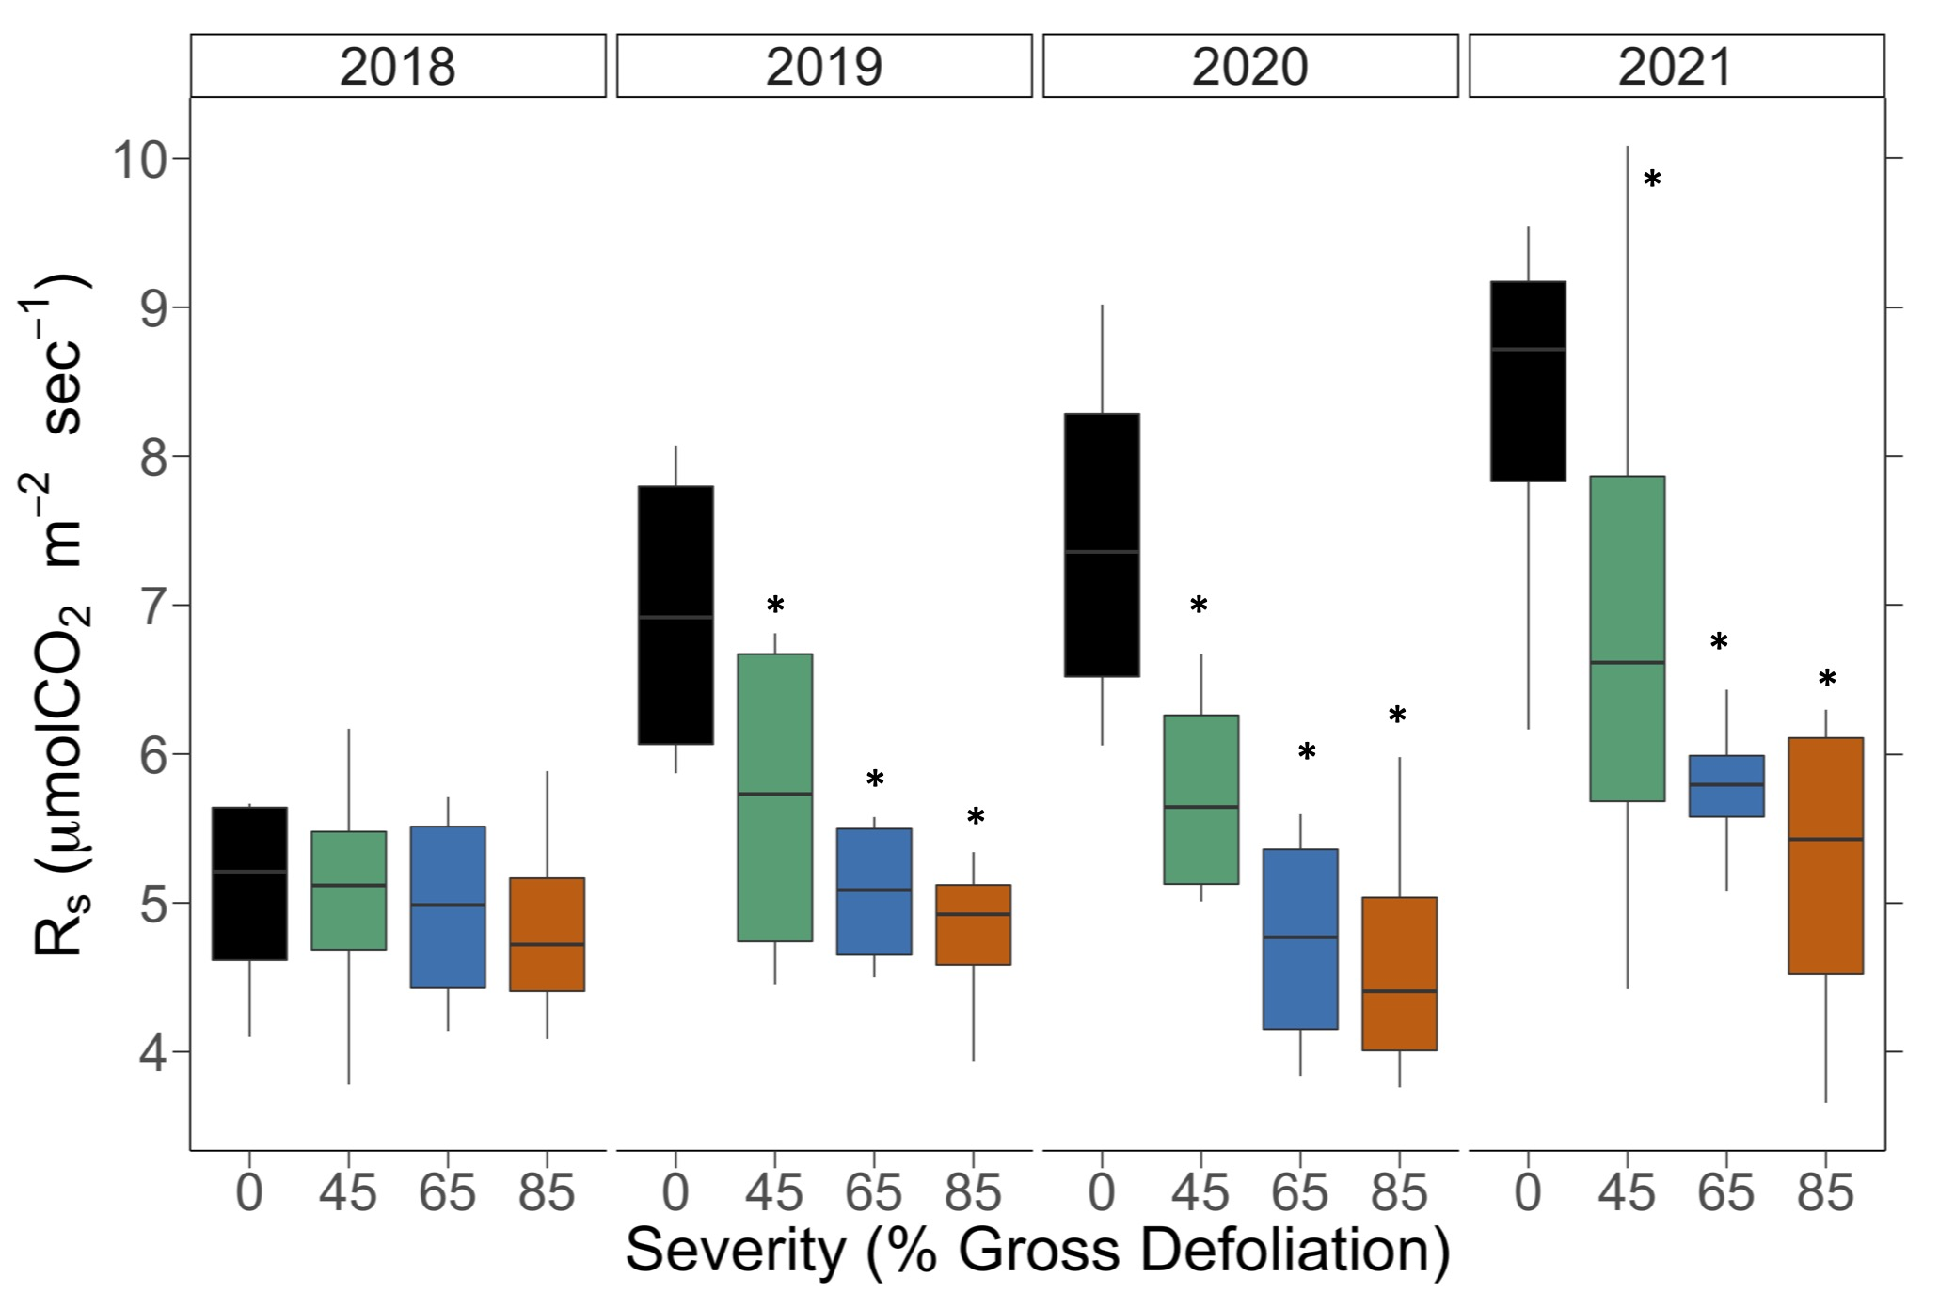

Soil respiration & disturbance severity
DRY
*p < 0.05
$$Y_{ijk}= μ+{Rep}_{i}+ {Year}_{j}+ {Severity}_{k|i}+Year∗{Sev}_{jk|i} [+ ε_{ijk}]$$

Slide 6
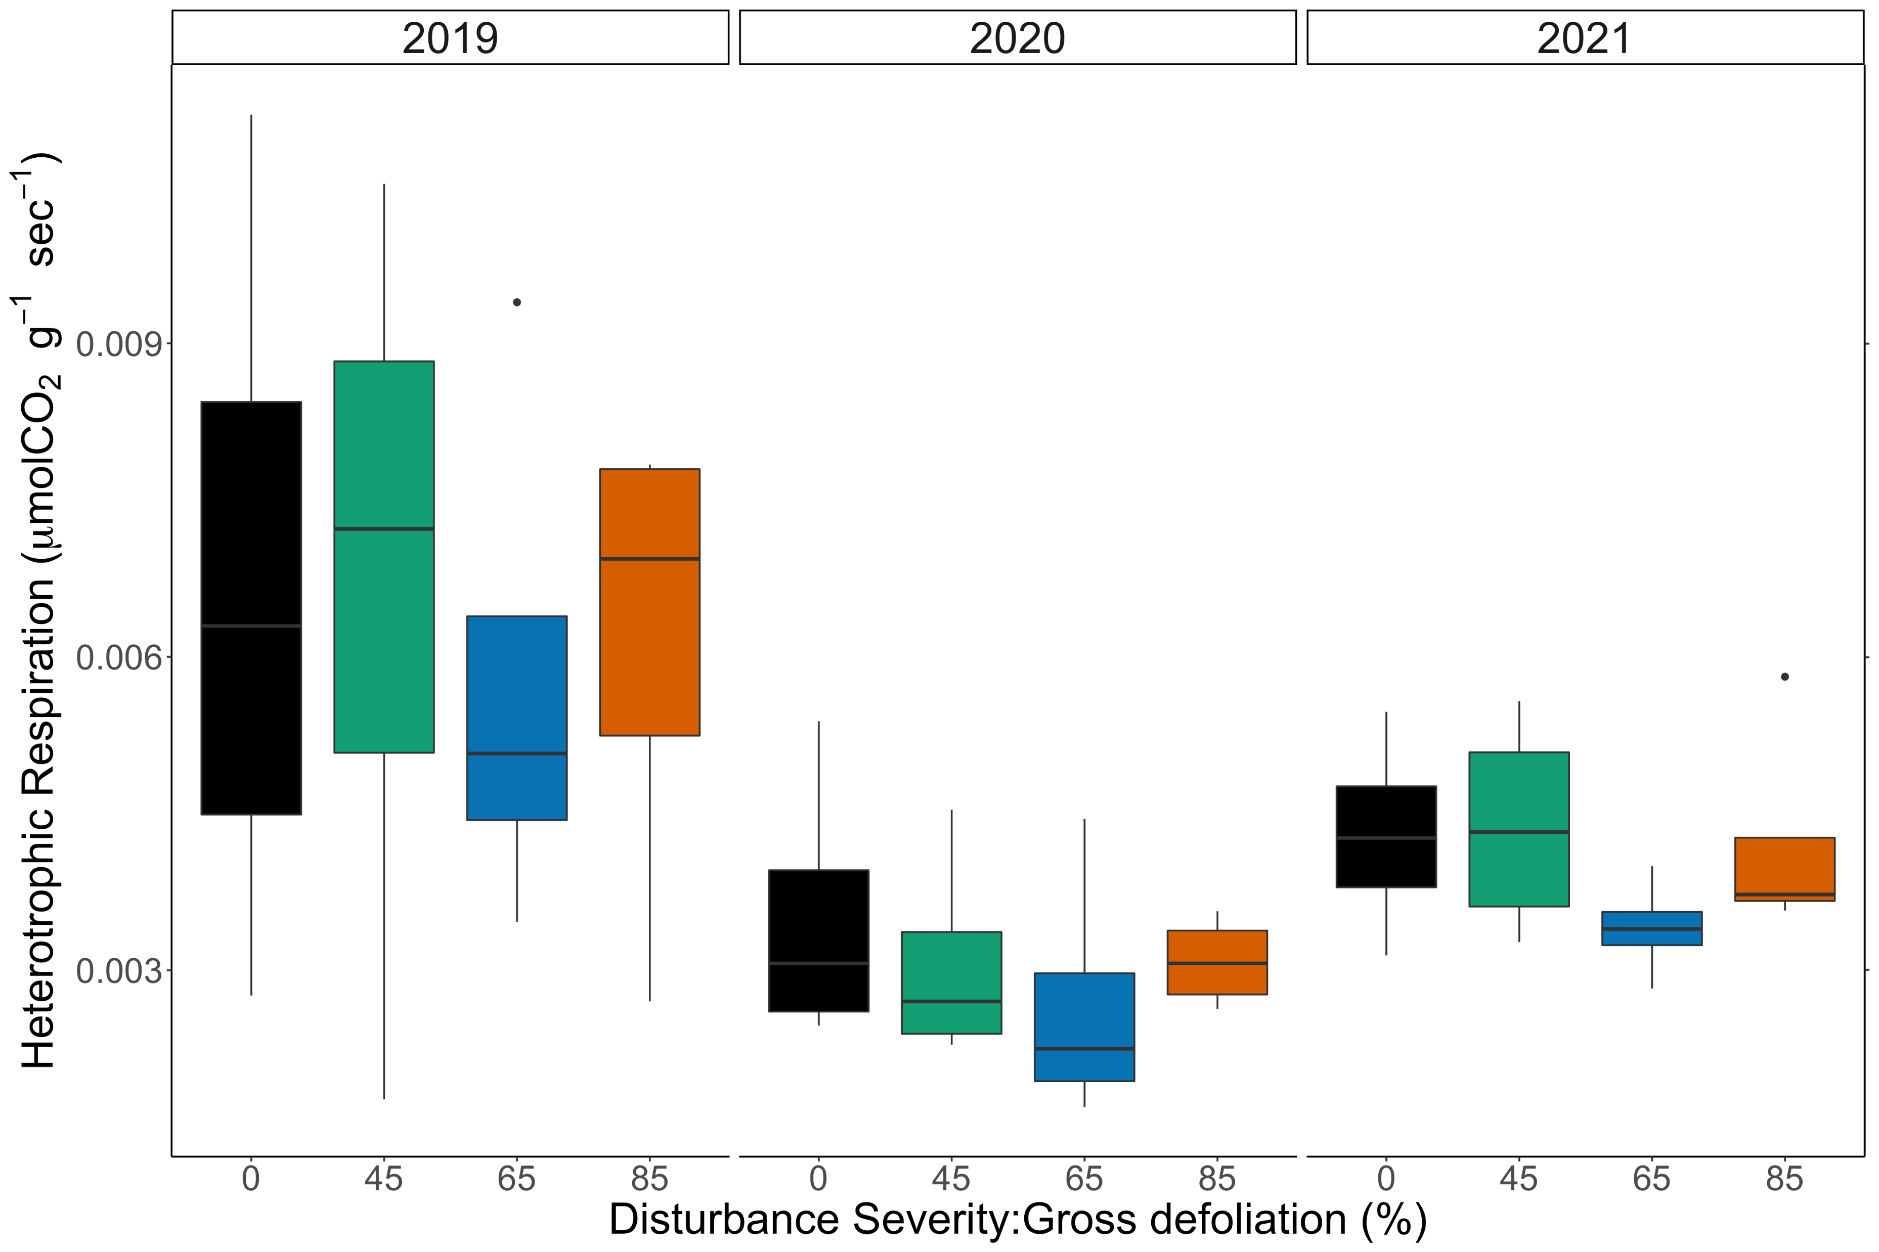

Heterotrophic Respiration & Disturbance severity
$${log⁡(Y}_{ijk})= μ+{Rep}_{i}+ {Year}_{j}+ {Severity}_{k|i}+Year∗{Sev}_{jk|i} [+ ε_{ijk}]$$

Slide 7
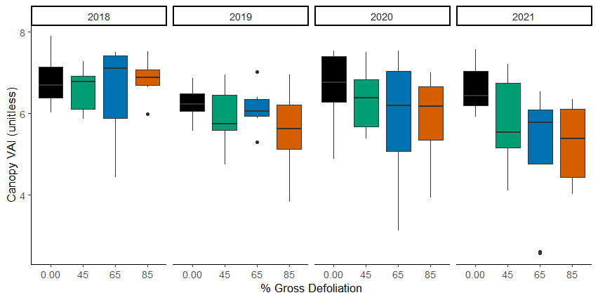

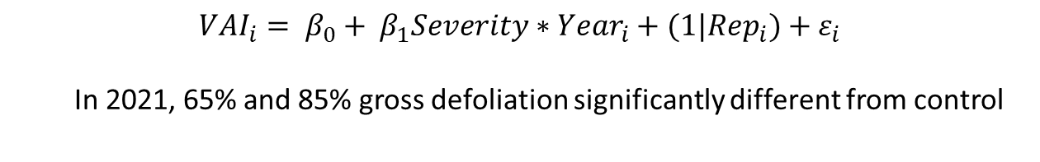
Canopy vegetative area index
*
**
* p < 0.05, ** p < 0.01
$${VAI}_{i}= β_{0}+ β_{1}{Severity∗Year}_{i}+{(1|Rep}_{i})+{ ε}_{i}$$
In 2021, 65% and 85% gross defoliation significantly different from control

Slide 8
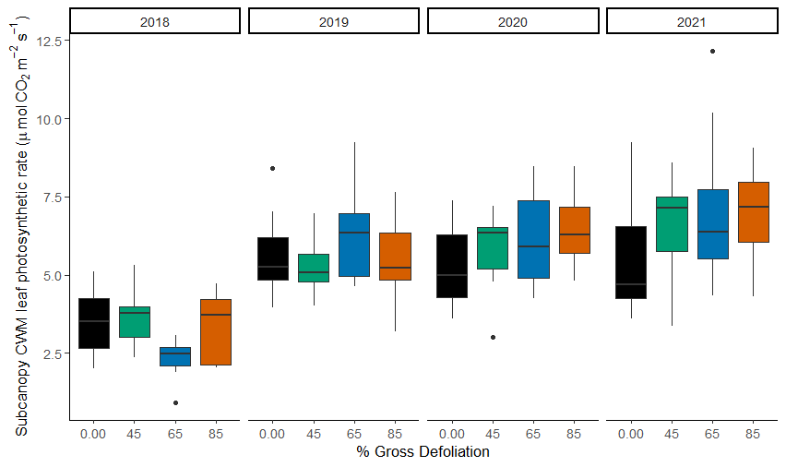

Subcanopy A_{sat}
*
*
*
* p < 0.05
$$Y_{ijk}= μ+{Rep}_{i}+ {Year}_{j}+ {Severity}_{k|i}+Year∗{Sev}_{jk|i} [+ ε_{ijk}]$$

Slide 9
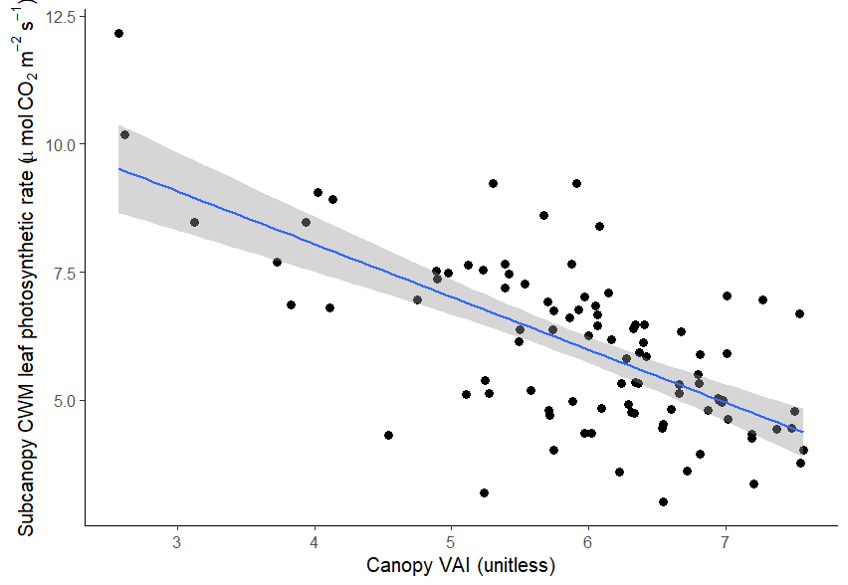
Following disturbance, canopy VAI predicts subcanopy A_{sat}
Higher disturbance drives lost canopy VAI over time
y = -1.03x + 12.16
p < 0.001

Slide 10
Image credit: Erika Masis Laverde, VCUarts

Slide 11
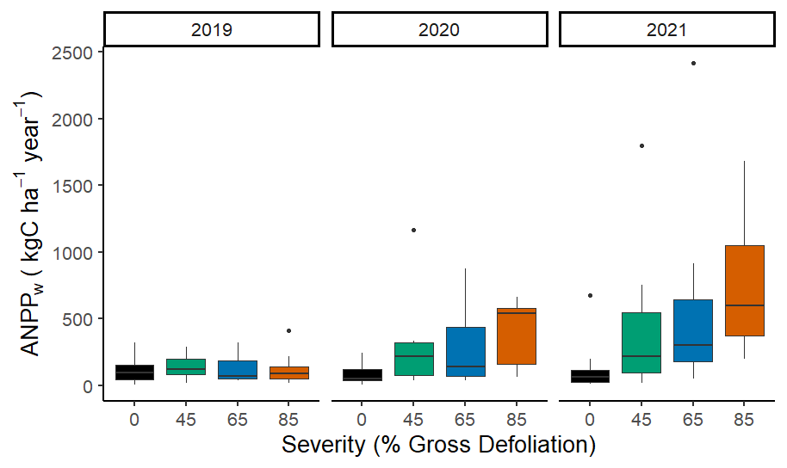

Subcanopy NPP
Neidermaier et al. in prep
Session B45P-04
*
*
*
*
*
*
* p < 0.05
$${log⁡(Y}_{ijk})= μ+{Rep}_{i}+ {Year}_{j}+ {Severity}_{k|i}+Year∗{Sev}_{jk|i} [+ ε_{ijk}]$$

Slide 12
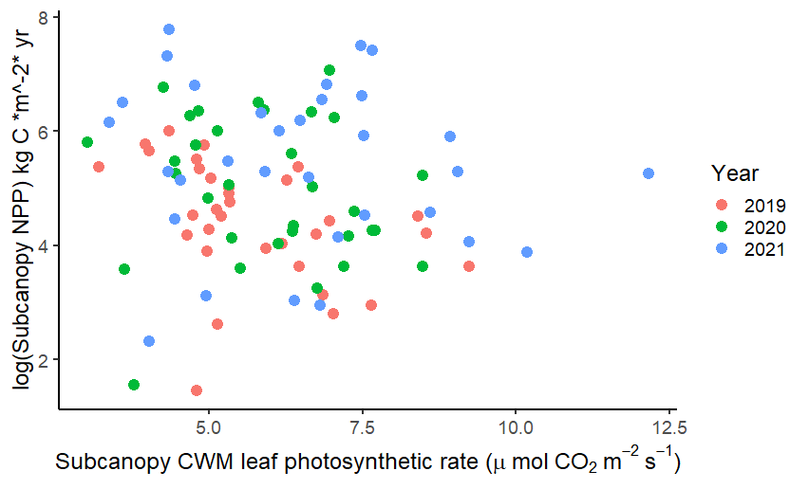
Subcanopy NPP is not well predicted by subcanopy A_{sat} alone

Slide 13
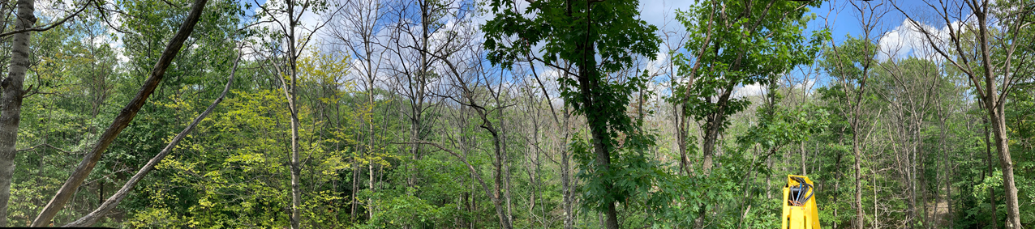
Key Preliminary Take-aways
Belowground…
R_{s} declines immediately and remains suppressed in 3 years following disturbance
Lower R_{s} is driven by declining R_{a}, not R_{h}, with rising disturbance severity
Aboveground…
Disintegration of closed canopy, and subsequent increases in subcanopy A_{sat}, lag initial disturbance via stem girdling
Implications for ecosystem C balance…
Sustained R_{h} coupled with increased subcanopy NPP may stabilize NEP despite lost canopy area
Even at upper extreme of disturbance severity, ecosystem C balance may be sustained due to offsetting (though temporally lagged) above- and belowground responses

Slide 14
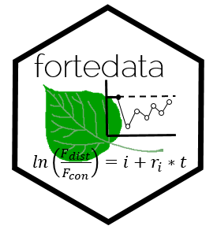

FoRTE posters @ AGU
Kalyn Dorheim et al.: B42A-10 - Modeling FoRTE, the Forest Resilience Threshold Experiment (Online)
Kerstin Niedermaier et al.: B45P-04 - Is net primary production resistance to disturbance in forests mediated by structural legacies? (Online)
Kayla Mathes et al.: B55A-1194 - Unraveling mechanisms underlying coupled above and below-ground carbon flux responses to increasing disturbance; Friday, 17 December 2021, 17:00-19:00; Convention Center – Poster Hall, D-F
Chris Gough et al.: B55A-1193 - Divergent patterns of forest carbon uptake and loss stabilize net carbon balance as disturbance severity increases; Friday, 17 December 2021; Convention Center – Poster Hall, D-F

Slide 15


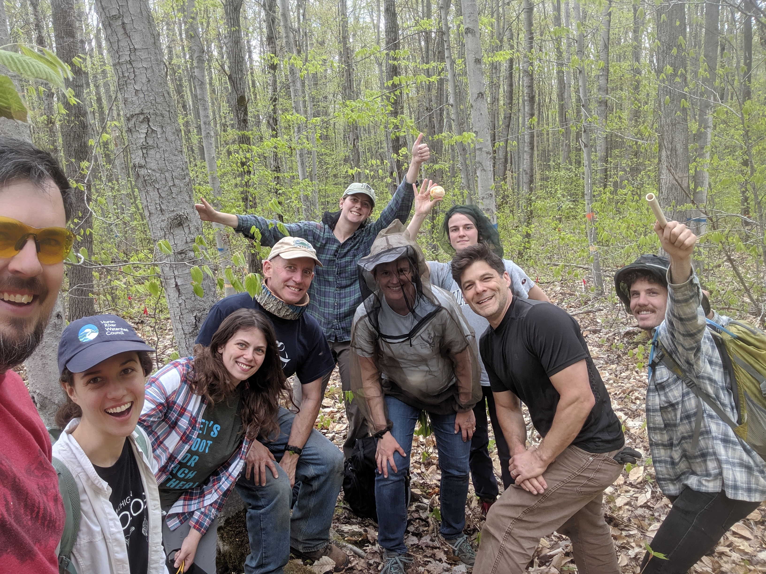
Acknowledgements
FoRTE is supported by the National Science Foundation
(DEB Award 1655095)
Also, huge thanks to the University of Michigan Biological Station!

